Slide 1

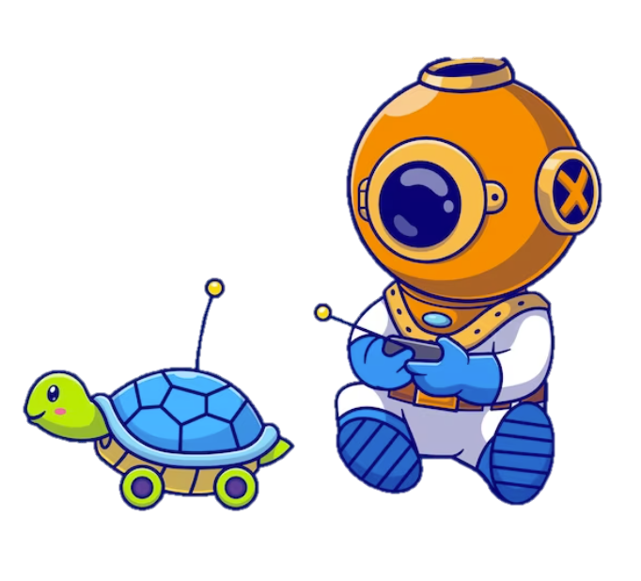
Machine
Learning
Demystifying the World of Artificial Intelligence and Exploring Its Potential

Slide 2
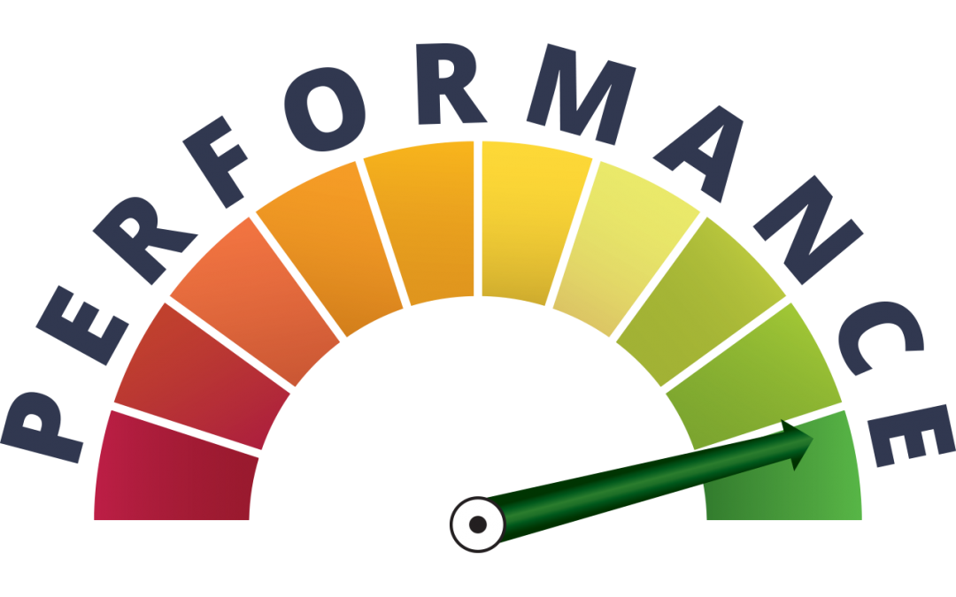
Classification Model Performance
There are many ways for measuring classification performance. Accuracy, confusion matrix, log-loss, and AUC-ROC are some of the most popular metrics.
Machine Learning

Slide 3
Accuracy
The ratio between the number of correctly predicted data points and the total number of data points.
If we evaluate a model on a test dataset of 1000 samples, and the model predicted the correct label of the sample
If we have 3 models for binary problem with 15%, 50% and 70% accuracy.
Order them from the best?
Is it always enough for model evaluation?
Machine Learning

Slide 4
Accuracy
We have 2 datasets:
Machine Learning

Slide 5
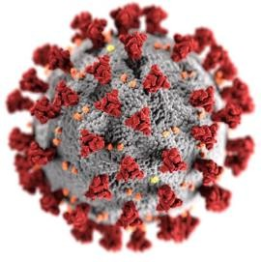
Accuracy
We have 2 datasets:
Medical Dataset
  A set of patient diagnosed with coronavirus
  A medical dataset with 1000 persons.
10 diagnosed with coronavirus
990 diagnosed as healthy
Labels “sick” or “healthy”.
Machine Learning

Slide 6

Accuracy
We have 2 datasets:
Medical Dataset
  A set of patient diagnosed with coronavirus
  A medical dataset with 1000 persons.
2. Email Dataset
  A set of emails labeled spam or ham
  A dataset of 100 emails.
10 diagnosed with coronavirus
990 diagnosed as healthy
Labels “sick” or “healthy”.
40 are spam
60 are ham
Labels are “spam” and “ham”
Machine Learning

Slide 7
Accuracy
Let’s back to our question:
“Is accuracy always enough for model evaluation?”
Suppose I tell you the following: “I have developed a test for coronavirus that takes 10 seconds to run, doesn’t require any examinations, and has an accuracy of 99%!”.
What do you think?
On our coronavirus dataset, If I tested all samples as healthy, my model accuracy is 99% !!!
Machine Learning

Slide 8
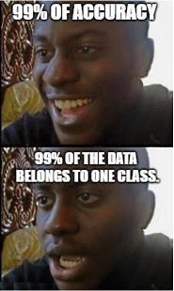
Accuracy
Let’s back to our question:
“Is accuracy always enough for model evaluation?”
Suppose I tell you the following: “I have developed a test for coronavirus that takes 10 seconds to run, doesn’t require any examinations, and has an accuracy of 99%!”.
What do you think?
On our coronavirus dataset, If I tested all samples as healthy, my model accuracy is 99% !!!
Machine Learning

Slide 9
Accuracy
Let’s back to our question:
“Is accuracy always enough for model evaluation?”
Suppose I tell you the following: “I have developed a test for coronavirus that takes 10 seconds to run, doesn’t require any examinations, and has an accuracy of 99%!”.
What do you think?
On our coronavirus dataset, If I tested all samples as healthy, my model accuracy is 99% !!!
What is the problem of our model?
The problem is that errors are not created equal, and some mistakes are much more expensive than others.
Machine Learning

Slide 10
False positives & False negatives
For coronavirus dataset:
False positive: A healthy person that gets incorrectly diagnosed as sick.
False negative: A sick person that gets incorrectly diagnosed as healthy.
True positive: A sick person that gets diagnosed as sick.
True negative: A healthy person that gets diagnosed as healthy.
Machine Learning

Slide 11
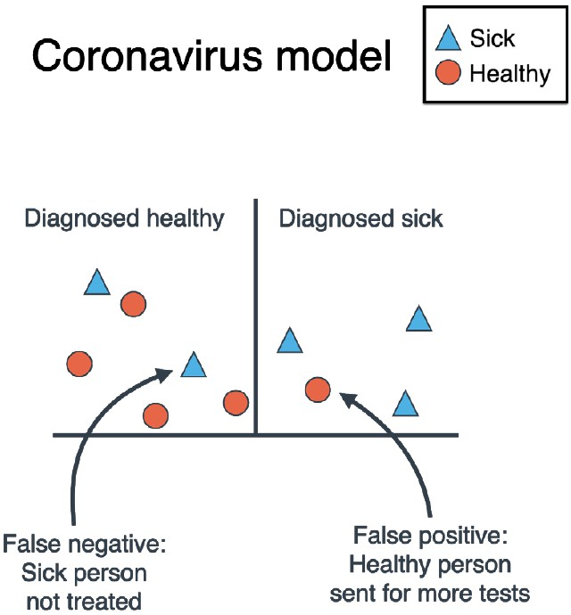
False positives & False negatives
For coronavirus dataset:
False positive: A healthy person that gets incorrectly diagnosed as sick.
False negative: A sick person that gets incorrectly diagnosed as healthy.
True positive: A sick person that gets diagnosed as sick.
True negative: A healthy person that gets diagnosed as healthy.
Machine Learning

Slide 12
False positives & False negatives
For coronavirus dataset:
False positive: A healthy person that gets incorrectly diagnosed as sick.
False negative: A sick person that gets incorrectly diagnosed as healthy.
True positive: A sick person that gets diagnosed as sick.
True negative: A healthy person that gets diagnosed as healthy.
3 - True Positives
4 - True Negatives
1 - False Positive
2 - False Negatives
Machine Learning

Slide 13
False positives & False negatives
For coronavirus dataset:
False positive: A healthy person that gets incorrectly diagnosed as sick.
False negative: A sick person that gets incorrectly diagnosed as healthy.
True positive: A sick person that gets diagnosed as sick.
True negative: A healthy person that gets diagnosed as healthy.
3 - True Positives
4 - True Negatives
1 - False Positive
2 - False Negatives
Find the same for the Spam dataset..
Machine Learning

Slide 14
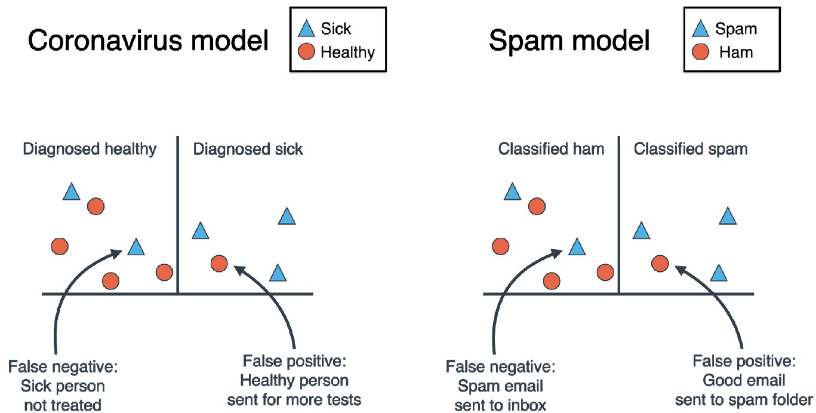
False positives & False negatives
Machine Learning

Slide 15
False positives & False negatives
Which is important for each dataset
False positives or False negatives?
In coronavirus it is more important to not have undetected sick people, So False Negative is more important
In spam model it is more important to not have ham mails in junk box So False Positive is more important.
Machine Learning

Slide 16
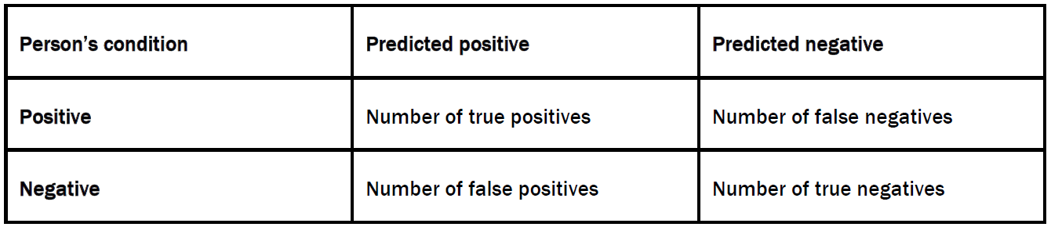
Confusion Matrix
It is called that because it tells how much the model is confused between 2 classes.
Number of rows = Number of columns = Number of classes.
In the rows we write the true labels (in the medical example, this is the condition of the person, sick or healthy) and in the columns we write the predicted labels (the diagnosis of the person, sick or healthy).
Machine Learning

Slide 17
Recall
It finds the proportion of correct positive predictions among the data points with a positive label.
Machine Learning

Slide 18
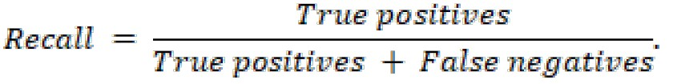
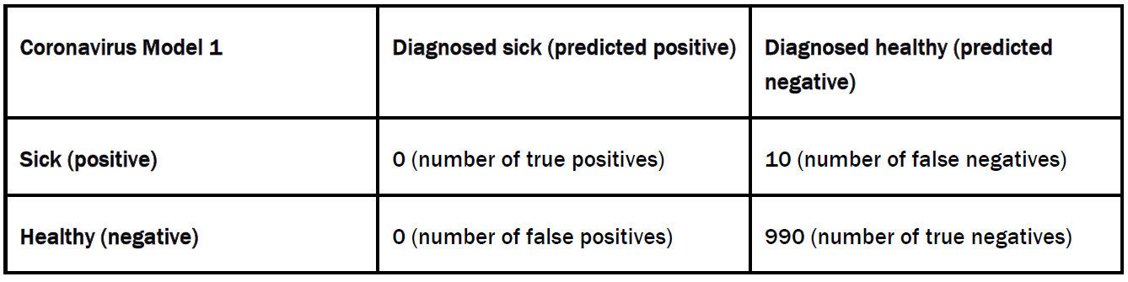
Recall
It finds the proportion of correct positive predictions among the data points with a positive label.
Machine Learning

Slide 19
Recall
It finds the proportion of correct positive predictions among the data points with a positive label.
Machine Learning

Slide 20
Recall
It finds the proportion of correct positive predictions among the data points with a positive label.
Machine Learning

Slide 21
Recall
It finds the proportion of correct positive predictions among the data points with a positive label.
Machine Learning

Slide 22
Recall
It finds the proportion of correct positive predictions among the data points with a positive label.
Machine Learning

Slide 23
Recall
It finds the proportion of correct positive predictions among the data points with a positive label.
Coronavirus Model has a total of 0 true positives among 10 positive-labeled, so its recall is 0/10 = 0.
Machine Learning

Slide 24
Precision
It finds the proportion of correct positive predictions among the data points with a positive prediction.
Machine Learning

Slide 25
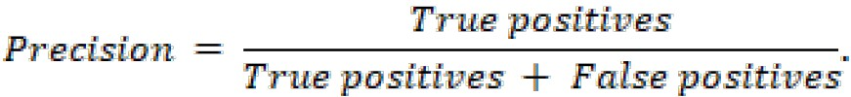
Precision
It finds the proportion of correct positive predictions among the data points with a positive prediction.
Machine Learning

Slide 26
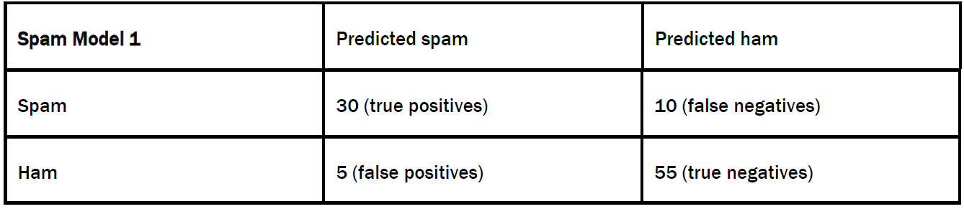
Precision
It finds the proportion of correct positive predictions among the data points with a positive prediction.
Machine Learning

Slide 27
Precision
It finds the proportion of correct positive predictions among the data points with a positive prediction.
Spam Model has a total of 30 true positives among 35 positive-predicted, so its precision is 30/35 = 86.7%
Machine Learning

Slide 28
Recall VS Precision
It finds the proportion of correct positive predictions among the data points with a positive prediction.
Machine Learning

Slide 29
Recall VS Precision
It finds the proportion of correct positive predictions among the data points with a positive prediction.
Machine Learning

Slide 30
Recall VS Precision
It finds the proportion of correct positive predictions among the data points with a positive prediction.
Positive labels that detected as negative Ex: corona patients diagnosed healthy
Machine Learning

Slide 31
Recall VS Precision
It finds the proportion of correct positive predictions among the data points with a positive prediction.
Positive labels that detected as negative Ex: corona patients diagnosed healthy
Negative labels that detected as positive
Ex: Ham mails detected as spam
Machine Learning

Slide 32
Recall VS Precision
It finds the proportion of correct positive predictions among the data points with a positive prediction.
Positive labels that detected as negative Ex: corona patients diagnosed healthy
Negative labels that detected as positive
Ex: Ham mails detected as spam
In the coronavirus model, False negatives is more important to be decreased as positive people should be diagnosed as positive, otherwise the pandemic will spread. High recall needed.
In the spam model, False positives is more important to be decreased as Ham mails should be detected as Ham, otherwise They will lost in junk. High precision needed.
We need a metric that combines both metrics with weights.
Machine Learning

Slide 33
F-score
How to combine between the recall and precision in one metric?
Average is not the best option.
If a model has, say, recall of 50% and precision of 100%, the average is 75%. This is a good score, but the model may not be, since a recall of 50% is not very good.
We use harmonic mean: 2ab/(a+b) a=1 and b=9, their average is 5.
The harmonic mean is 1.8 which is better for our case.
Machine Learning

Slide 34

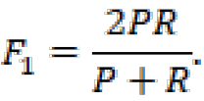
F-score
How to combine between the recall and precision in one metric?
Average is not the best option.
If a model has, say, recall of 50% and precision of 100%, the average is 75%. This is a good score, but the model may not be, since a recall of 50% is not very good.
We use harmonic mean: 2ab/(a+b) a=1 and b=9, their average is 5.
The harmonic mean is 1.8 which is better for our case.
If β = 1
Recall and precision has the same weight
Machine Learning

Slide 35

F-score
How to combine between the recall and precision in one metric?
Average is not the best option.
If a model has, say, recall of 50% and precision of 100%, the average is 75%. This is a good score, but the model may not be, since a recall of 50% is not very good.
We use harmonic mean: 2ab/(a+b) a=1 and b=9, their average is 5.
The harmonic mean is 1.8 which is better for our case.
If β = 1
If β > 1 say 10
Recall and precision has the same weight
Recall has a weight more than precision
Machine Learning

Slide 36

F-score
How to combine between the recall and precision in one metric?
Average is not the best option.
If a model has, say, recall of 50% and precision of 100%, the average is 75%. This is a good score, but the model may not be, since a recall of 50% is not very good.
We use harmonic mean: 2ab/(a+b) a=1 and b=9, their average is 5.
The harmonic mean is 1.8 which is better for our case.
If β = 1
If β > 1 say 10
If β < 1 say 0.1
Recall and precision has the same weight
Recall has a weight more than precision
Precision has a weight more than recall
Machine Learning

Slide 37
F-score
How to combine between the recall and precision in one metric?
Average is not the best option.
If a model has, say, recall of 50% and precision of 100%, the average is 75%. This is a good score, but the model may not be, since a recall of 50% is not very good.
We use harmonic mean: 2ab/(a+b) a=1 and b=9, their average is 5.
The harmonic mean is 1.8 which is better for our case.
If β = 1
If β > 1 say 10
If β < 1 say 0.1
R= 0.1
P= 0.9
Recall and precision has the same weight
Recall has a weight more than precision
Precision has a weight more than recall
Machine Learning

Slide 38
F-score
How to combine between the recall and precision in one metric?
Average is not the best option.
If a model has, say, recall of 50% and precision of 100%, the average is 75%. This is a good score, but the model may not be, since a recall of 50% is not very good.
We use harmonic mean: 2ab/(a+b) a=1 and b=9, their average is 5.
The harmonic mean is 1.8 which is better for our case.
If β = 1
If β > 1 say 10
If β < 1 say 0.1
R= 0.1
P= 0.9
= 0.18
Recall and precision has the same weight
Recall has a weight more than precision
Precision has a weight more than recall
Machine Learning

Slide 39
F-score
How to combine between the recall and precision in one metric?
Average is not the best option.
If a model has, say, recall of 50% and precision of 100%, the average is 75%. This is a good score, but the model may not be, since a recall of 50% is not very good.
We use harmonic mean: 2ab/(a+b) a=1 and b=9, their average is 5.
The harmonic mean is 1.8 which is better for our case.
If β = 1
If β > 1 say 10
If β < 1 say 0.1
R= 0.1
P= 0.9
= 0.18
= 0.10
Recall and precision has the same weight
Recall has a weight more than precision
Precision has a weight more than recall
Machine Learning

Slide 40
F-score
How to combine between the recall and precision in one metric?
Average is not the best option.
If a model has, say, recall of 50% and precision of 100%, the average is 75%. This is a good score, but the model may not be, since a recall of 50% is not very good.
We use harmonic mean: 2ab/(a+b) a=1 and b=9, their average is 5.
The harmonic mean is 1.8 which is better for our case.
If β = 1
If β > 1 say 10
If β < 1 say 0.1
R= 0.1
P= 0.9
= 0.18
= 0.10
= 0.83
Recall and precision has the same weight
Recall has a weight more than precision
Precision has a weight more than recall
Machine Learning

Slide 41
Sensitivity and Specificity
Sensitivity (true positive rate): It finds the proportion of correct positive predictions among the data points with positive label. [Recall]
Machine Learning

Slide 42
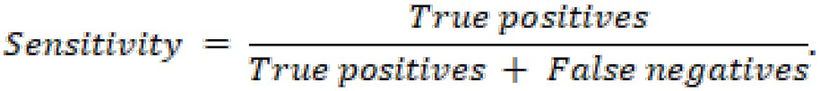
Sensitivity and Specificity
Sensitivity (true positive rate): It finds the proportion of correct positive predictions among the data points with positive label. [Recall]
Machine Learning

Slide 43
Sensitivity and Specificity
Sensitivity (true positive rate): It finds the proportion of correct positive predictions among the data points with positive label. [Recall]
Specificity (true negative rate): It finds the proportion of correct Negative predictions among the data points with Negative label.
Machine Learning

Slide 44
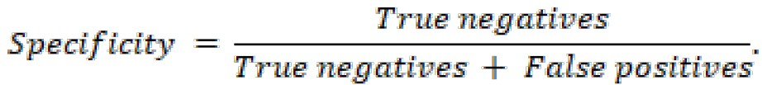
Sensitivity and Specificity
Sensitivity (true positive rate): It finds the proportion of correct positive predictions among the data points with positive label. [Recall]
Specificity (true negative rate): It finds the proportion of correct Negative predictions among the data points with Negative label.
Machine Learning

Slide 45
Sensitivity and Specificity
Sensitivity (true positive rate): It finds the proportion of correct positive predictions among the data points with positive label. [Recall]
Specificity (true negative rate): It finds the proportion of correct Negative predictions among the data points with Negative label.
In the coronavirus model,
the sensitivity is the proportion of sick people that the model has correctly diagnosed, among all the sick people.
The specificity is the proportion of healthy people the model has correctly diagnosed, among the healthy people.
Since we are more concerned about correctly diagnosing the sick people, we need the coronavirus model to have high sensitivity.
Machine Learning

Slide 46
Sensitivity and Specificity
Sensitivity (true positive rate): It finds the proportion of correct positive predictions among the data points with positive label. [Recall]
Specificity (true negative rate): It finds the proportion of correct Negative predictions among the data points with Negative label.
In the coronavirus model,
the sensitivity is the proportion of sick people that the model has correctly diagnosed, among all the sick people.
The specificity is the proportion of healthy people the model has correctly diagnosed, among the healthy people.
Since we are more concerned about correctly diagnosing the sick people, we need the coronavirus model to have high sensitivity.
In the spam detection model,
the sensitivity is the proportion of spam messages we correctly deleted, among all the spam messages.
The specificity is the proportion of ham emails we correctly sent to the inbox, among all the ham emails.
Since we are more concerned about correctly detecting the ham emails, we need the spam detection model to have high specificity.
Machine Learning

Slide 47
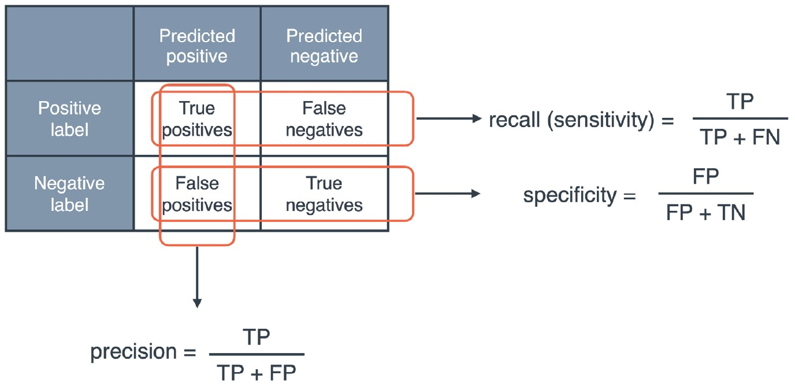

Recall , Precision, Sensitivity and Specificity
Machine Learning

Slide 48
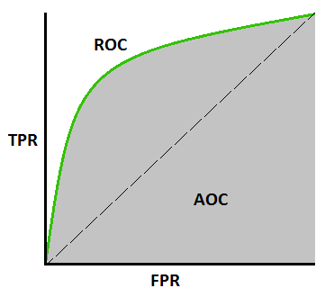
ROC (Receiver Operating Characteristic)
Machine Learning

Slide 49
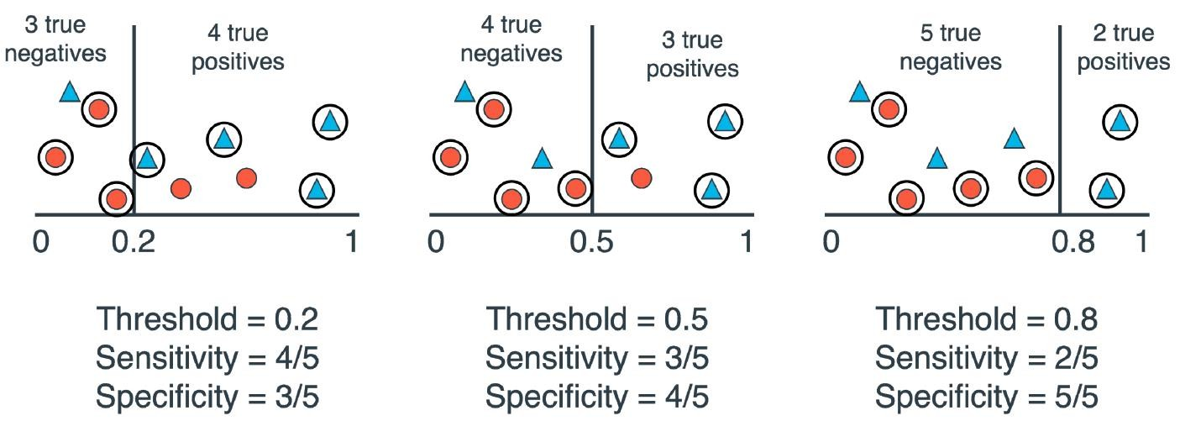
ROC (Receiver Operating Characteristic)
Machine Learning

Slide 50
ROC (Receiver Operating Characteristic)
Machine Learning

Slide 51
ROC (Receiver Operating Characteristic)
Machine Learning

Slide 52
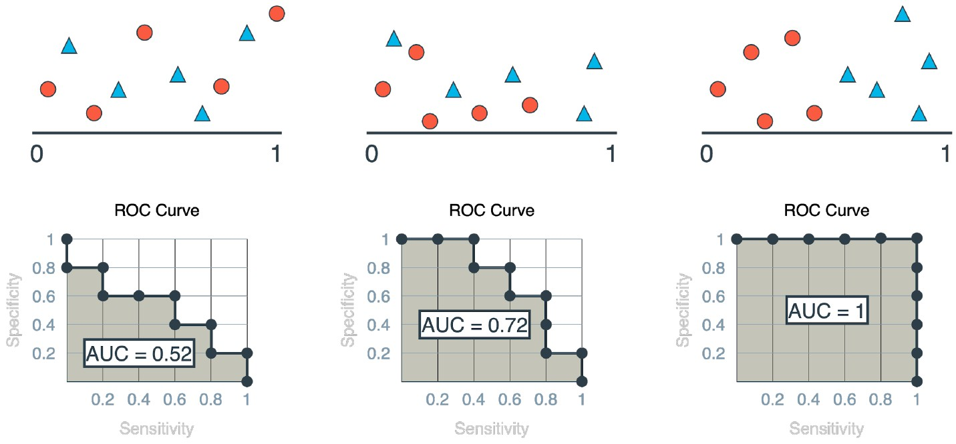
AUC (Area Under the Curve)
Machine Learning

Slide 53
AUC (Area Under the Curve)
Machine Learning

Slide 54
AUC (Area Under the Curve)
Machine Learning

Slide 55
AUC (Area Under the Curve)
Area Under the Curve tells us how much our model separate the classes.
Machine Learning

Slide 56
Decision based on ROC
As we increase or decrease the threshold, we change the sensitivity and specificity of the model, and this change is illustrated by moving in the ROC curve.
Machine Learning

Slide 57
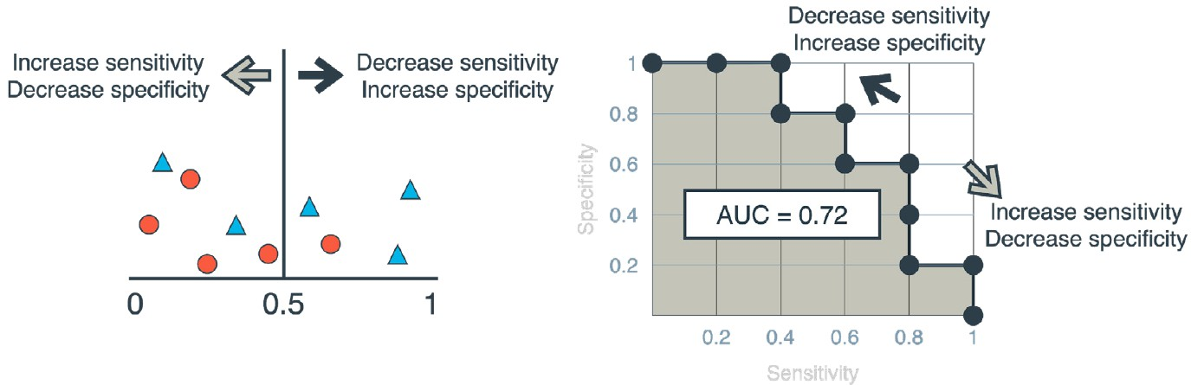
Decision based on ROC
As we increase or decrease the threshold, we change the sensitivity and specificity of the model, and this change is illustrated by moving in the ROC curve.
Machine Learning

Slide 58
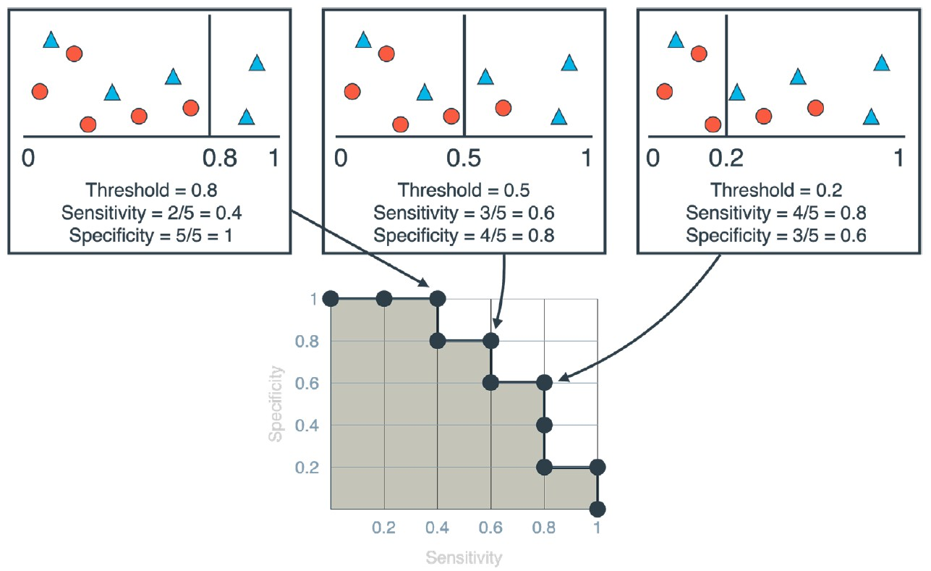
Decision based on ROC
Mapping the threshold and its ROC.
The model in the left has a high threshold, low sensitivity, and high specificity.
The model in the middle has medium values for threshold, sensitivity, and specificity.
The model in the right has a low threshold, high sensitivity, and low specificity.
Machine Learning

Slide 59
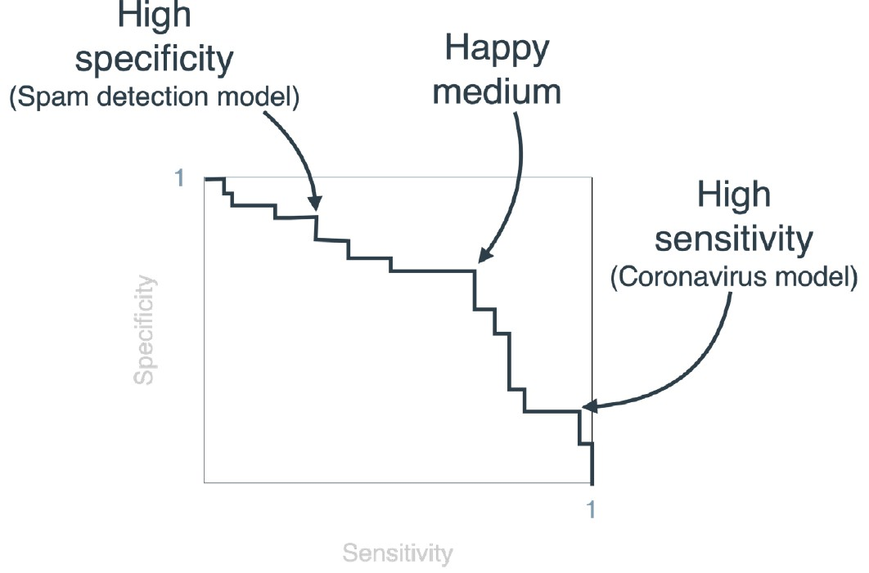
Decision based on ROC
For problems that needs high sensitivity (like coronavirus model), we uses ROC to choose a threshold that achieves that.
For problems that needs high specificity (like spam detector model), we uses ROC to choose a threshold that achieves that.
Machine Learning

Slide 60
Decision based on ROC
Machine Learning

Slide 61
Decision based on ROC
Usually we plot specificity VS 1-sensitivity
Machine Learning

Slide 62
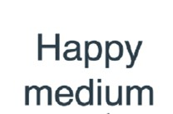
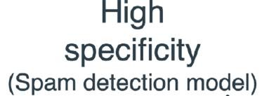
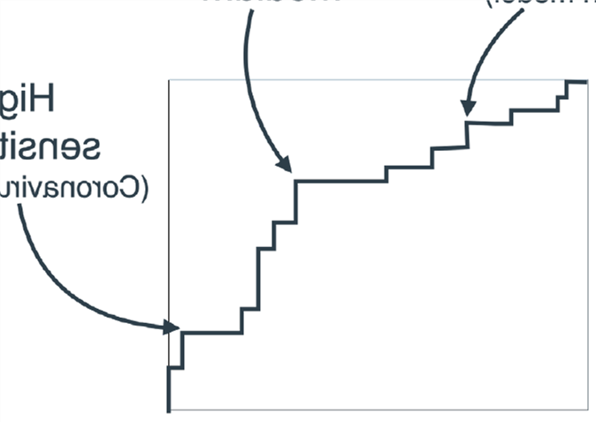

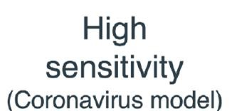

Decision based on ROC
specificity
specificity
1-sensitivity
sensitivity
Usually we plot specificity VS 1-sensitivity
Machine Learning

Slide 63
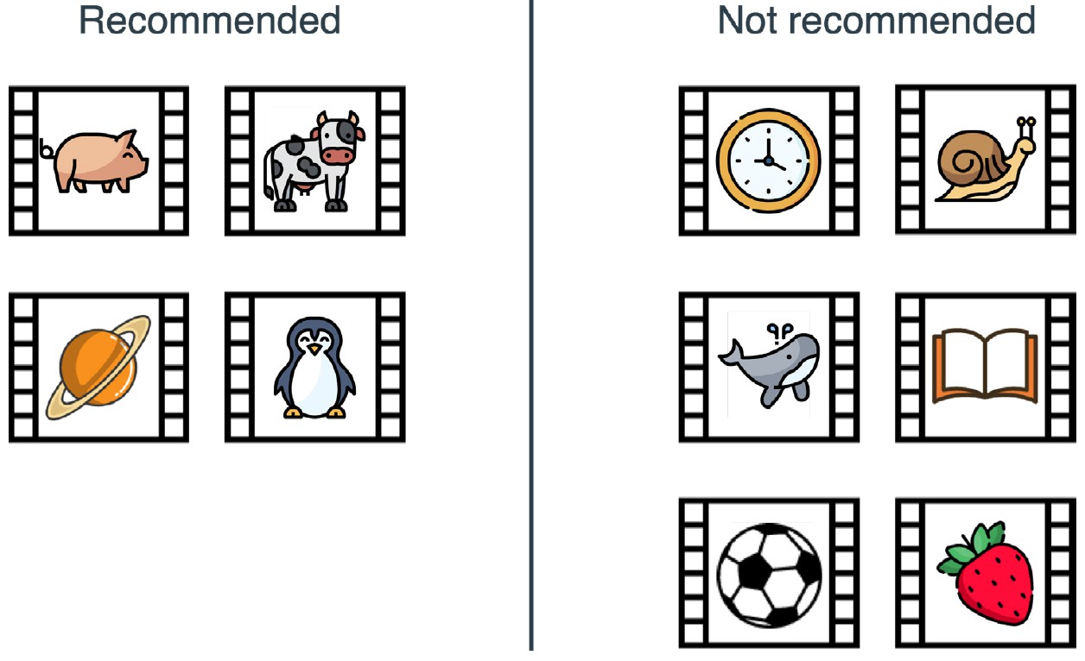
Exercise 01
A video site has established that a particular user likes animal videos and absolutely nothing else. You can see the recommendations that this user got when logging into the site.
What is the accuracy of the model?
What is the recall of the model?
What is the precision of the model?
What is the F1-score of the model?
Would you say that this is a good recommendation model?
Machine Learning

Slide 64
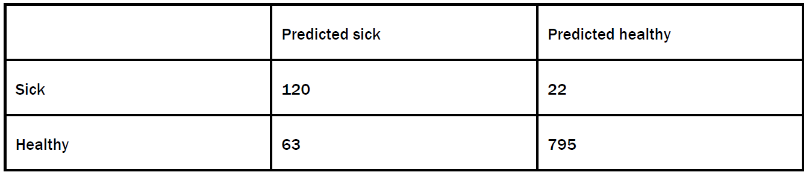
Exercise 02
Find the sensitivity and specificity of the medical model with the following confusion matrix.
Machine Learning

Slide 65
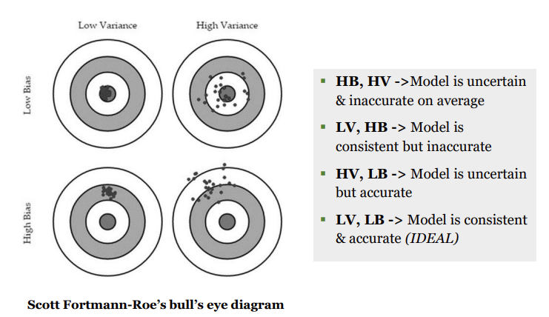

Bias-Variance Tradeoff
Machine Learning
HERE

Slide 66
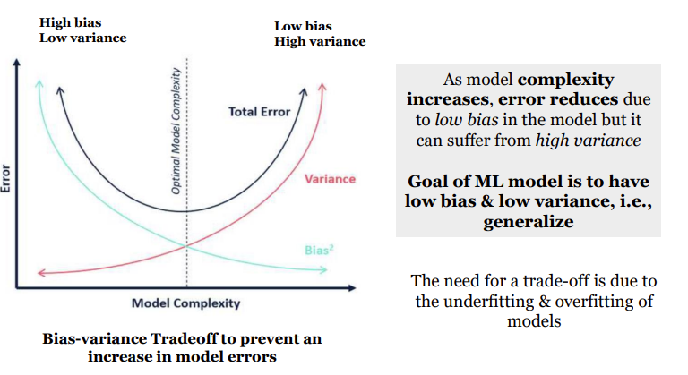
Bias-Variance Tradeoff
Machine Learning

Slide 67
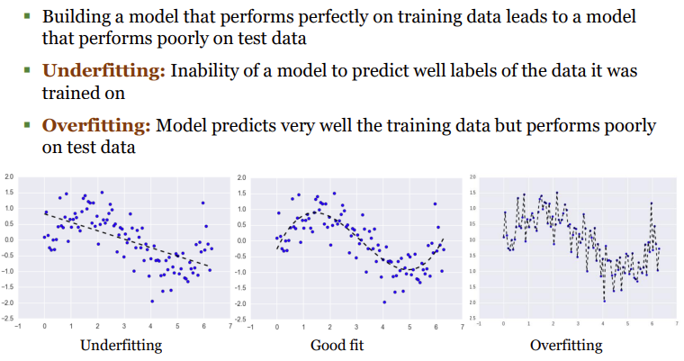
Underfitting & Overfitting
Machine Learning

Slide 68
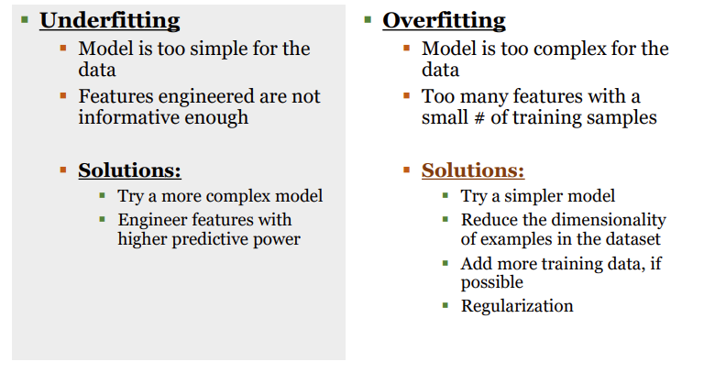
Reasons for Underfitting/Overfitting
Machine Learning

Slide 69
THANK YOU!
Any Question!

